Slide 1
About staying young
According to science

Slide 2






About me
Jesus Gonzalez VAZQUEZ
Jesus BASAIL

Slide 3
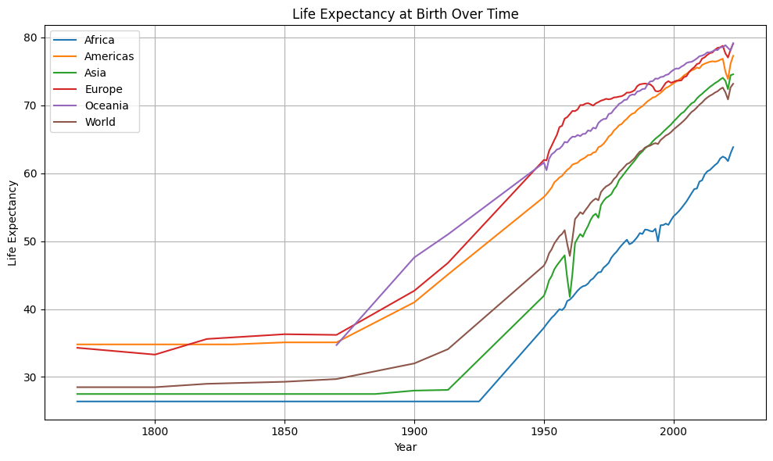
Longevity increase timeline
Data source: UN WPP (2024); HMD (2024); Zijdeman et al. (2015); Riley (2005) OurWorldinData.org/life-expectancy

Slide 4
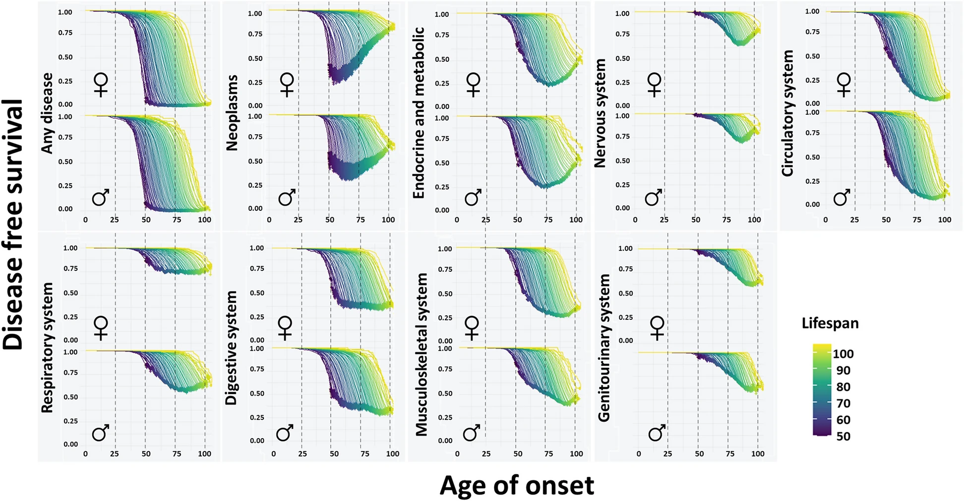
Health span Morbidity compression
Source: Human lifespan and sex-specific patterns of resilience to disease: a retrospective population-wide cohort study, Joaquim Sol, Marta Ortega-Bravo

Slide 5

Science backed
Source: 2024 Longevity Summit.
Eric Verdin, MD
President and CEO
Buck Institute for Research on Aging

Slide 6
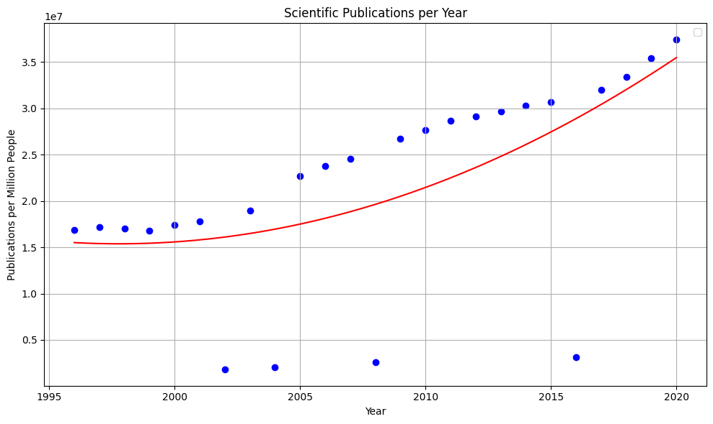
Information overload

Slide 7
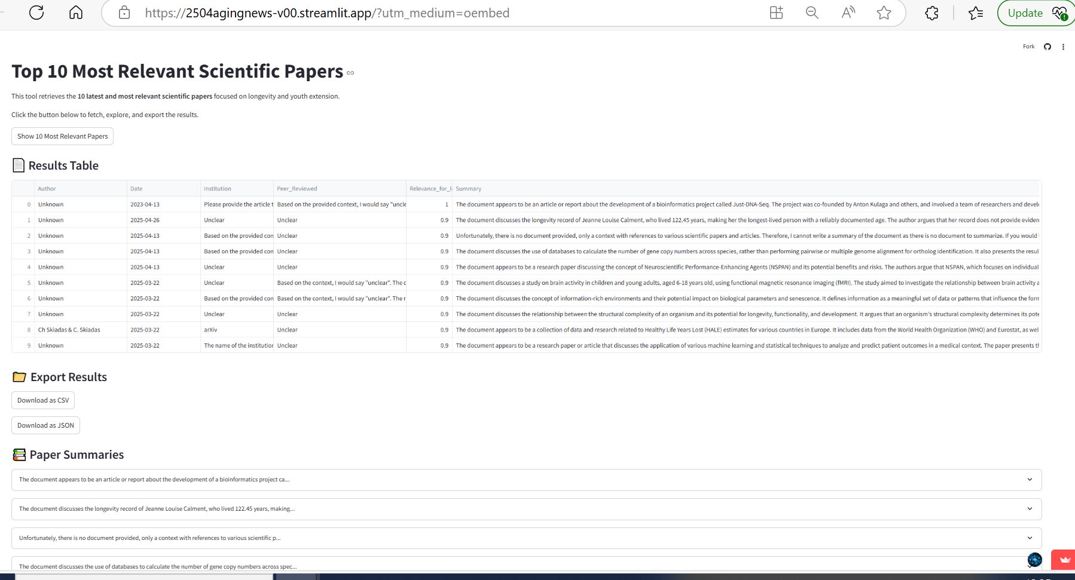
Our solution: App filtering

Slide 8
Features & Functionality
Uses NLP, AI technology and DS principles
Takes real data from the web
Assigns relevance
Creates a summary of each document
On the press of a button
Displays a list with the most important info
Results can be downloaded

Slide 9
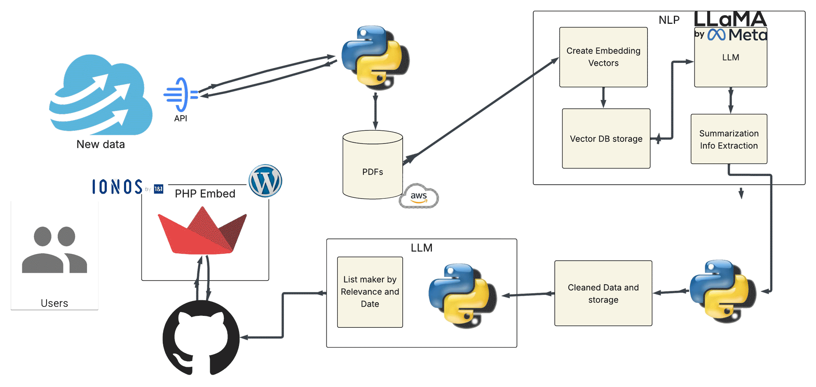
Our solution: Workflow

Slide 10
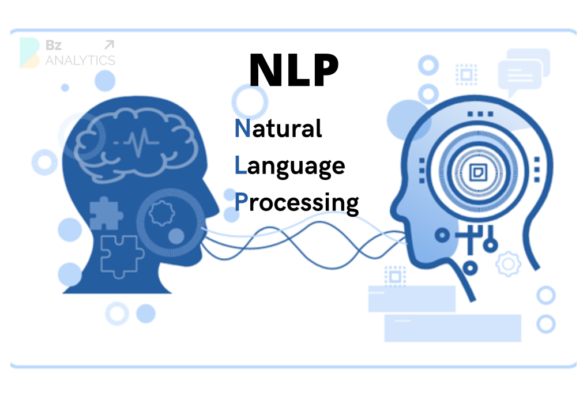






Tech Stack & Tools:
Python 3.12
Llama3-8b-8192
sentence-transformers/all-mpnet-base-v2
AWS S3 Storage
IONOS www.jesusbasail.com
Sreamlit, GitHub
Wordpress
Storage for Scraping: AWS- S
Public Databases: PubMed, Nature, ArXiv
API’s

Slide 11
Metrics:
Not easy
Not easy to implement
Important
Use LLM to create eval DS
Relevance difference to Summarization
Current common practice is human evaluation

Slide 12
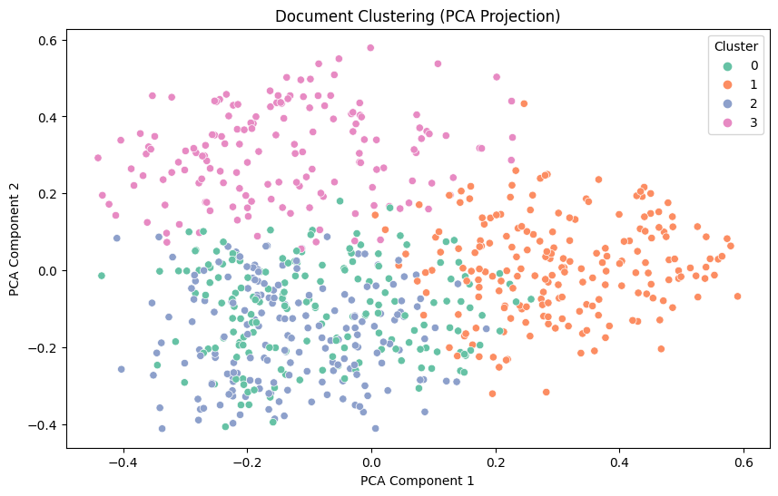
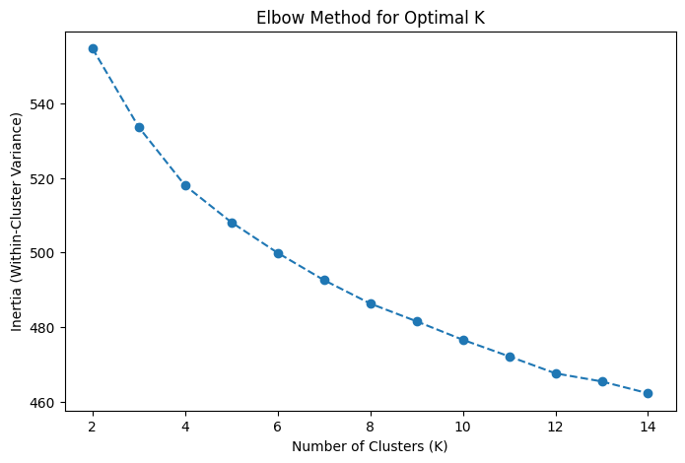
Learning Curve and base model: BERT

Slide 13
Conclusion & Future Work

Slide 14
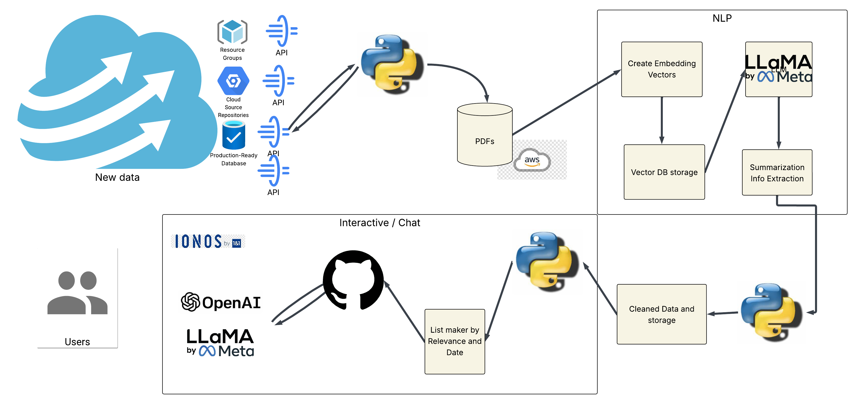
Future:

Slide 15
Thank you, questions?
Jesus gonzalez vazquez
+49 160 807 6571
email@jesusbasail.COM
WWW.jesusbasail.COM

